Slide 1

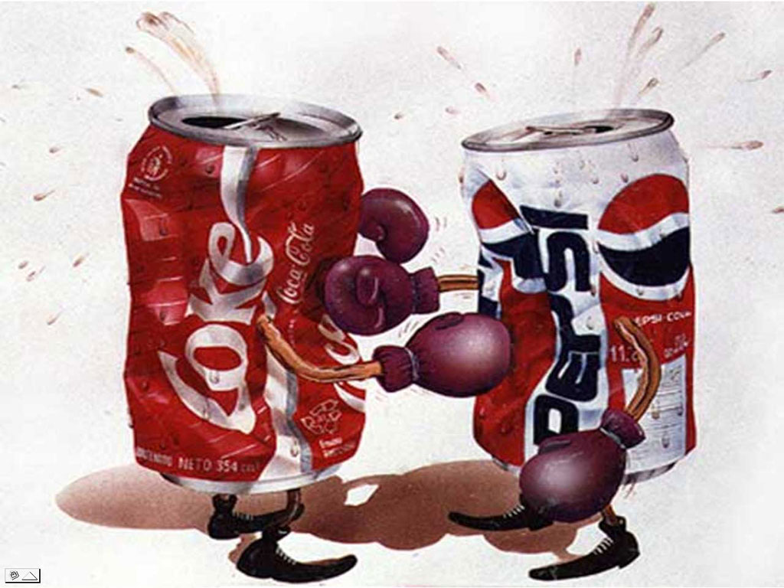
Unique Aspects of the Sport (product)
1
Sport organization must compete and cooperate.

Slide 2
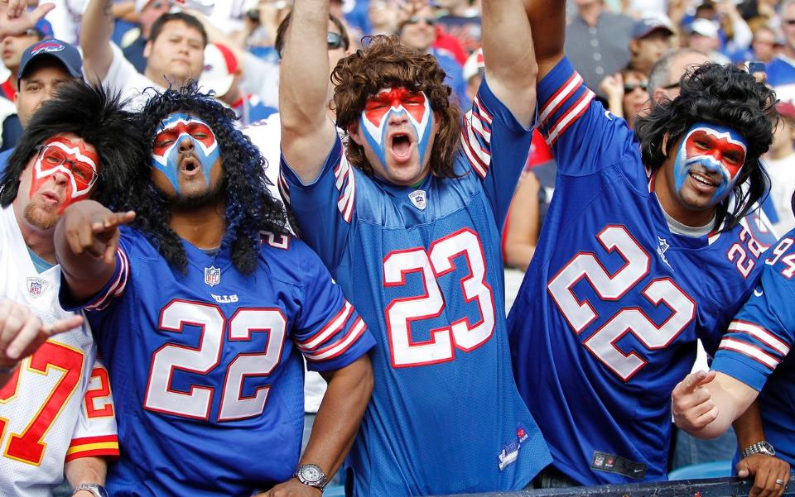

Unique Aspects of the Sport (product)
2
Sport consumers are experts.
Notes:
Managerial decisions such as player acquisition and strategies in sport do not go unnoticed and the sport consumer considers himself/herself an expert on running the team.
Dell computers rarely communicate detailed design and technological information and rarely have radio talk shows devoted to company operations.

Slide 3
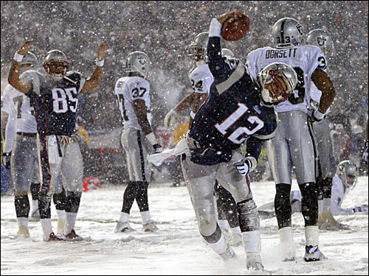
Unique Aspects of the Sport (product)
3
Supply and demand fluctuates.
Notes:
Sport participation opportunities can be determined by the environmental factors such as climate.

Slide 4

Unique Aspects of the Sport (product)
4
Sport is an intangible product.

Slide 5
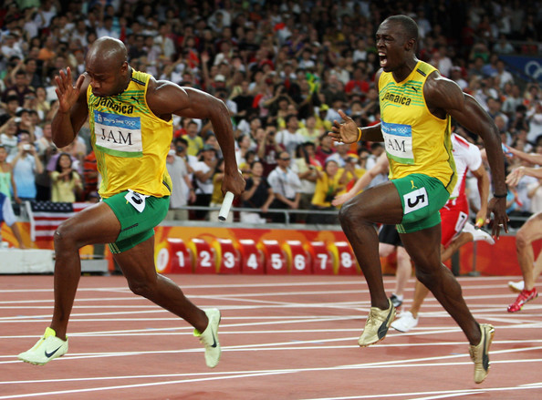
Unique Aspects of the Sport (product)
5
Sports are produced and consumed at the same time.
Notes:
Sports are produced and consumed at the same time.

Slide 6
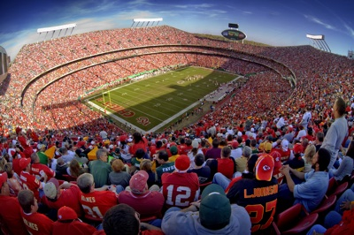
Unique Aspects of the Sport (product)
6
Social facilitation via sport
2%
Notes:
Sport is consumed in the presence of others. Less than 2% of spectators attend games by themselves.

Slide 7

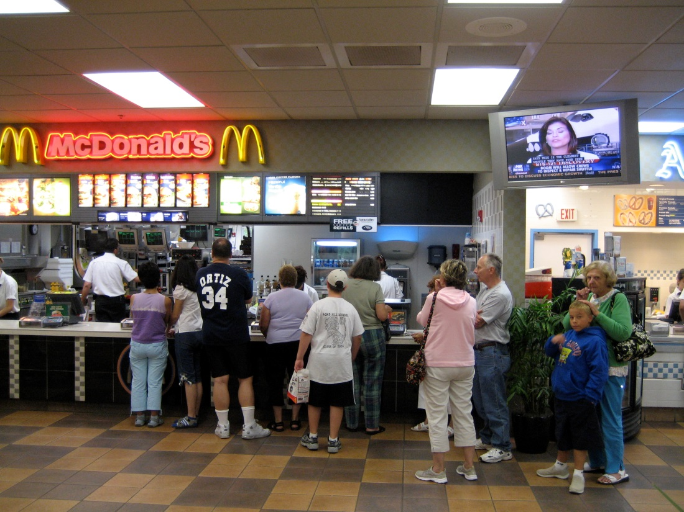
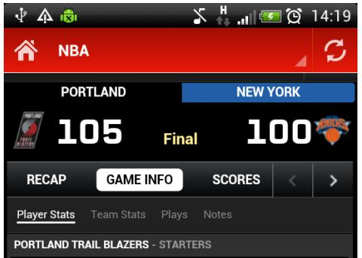
Unique Aspects of the Sport (product)
7
Inconsistent nature of the product (outcome uncertainty).

Slide 8


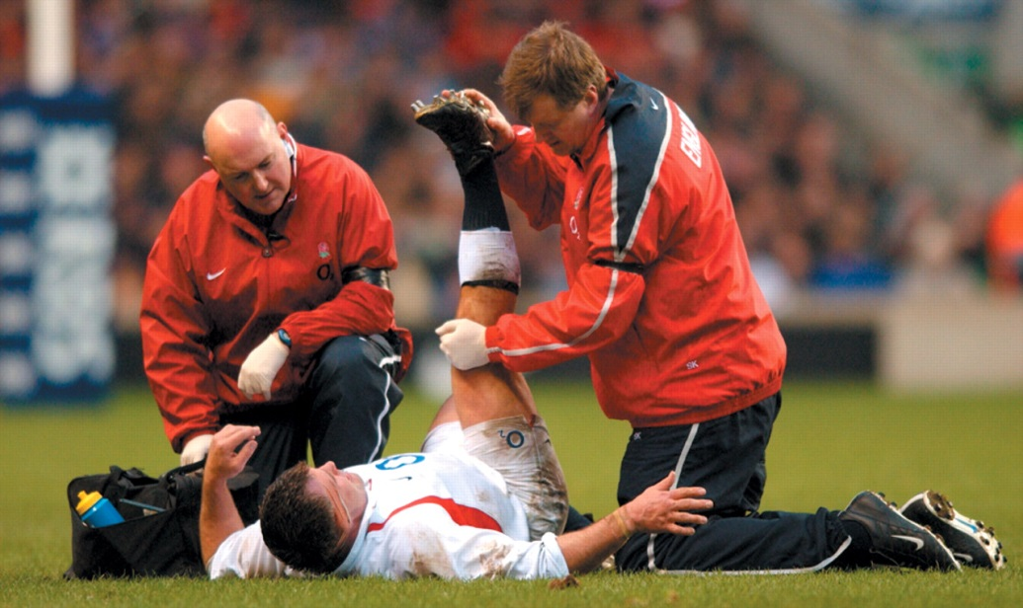
Unique Aspects of the Sport (product)
8
Lack of control over the core product.
Notes:
Sport managers and coaches can trade, the league control rules and regulations, and athletes get hurt.

Slide 9

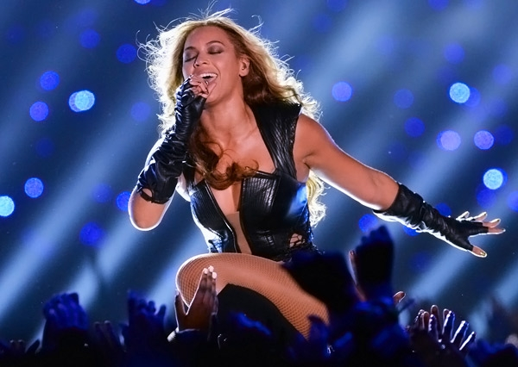
Unique Aspects of the Sport (product)
9
Reliance on product extensions.
Notes:
Halftime show, pre-game promotion, music and various activities.
Much of the sport experience involves elements not related to the core product.

Slide 10
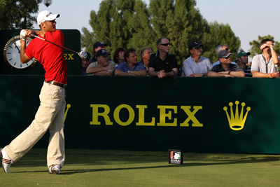
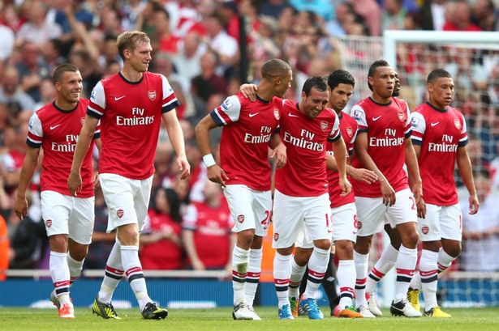
Unique Aspects of the Sport (product)
10
Consumer vs. industrial nature of sport
Notes:
Sport is both a consumer product and an industrial product.

Slide 11
Questions?

